Slide 1
00. Introduction
Quick information about the slides and the book

Slide 2
The Slides
You’re Reading them
They will all be over Google Drive for now to remain platform independent

Slide 3
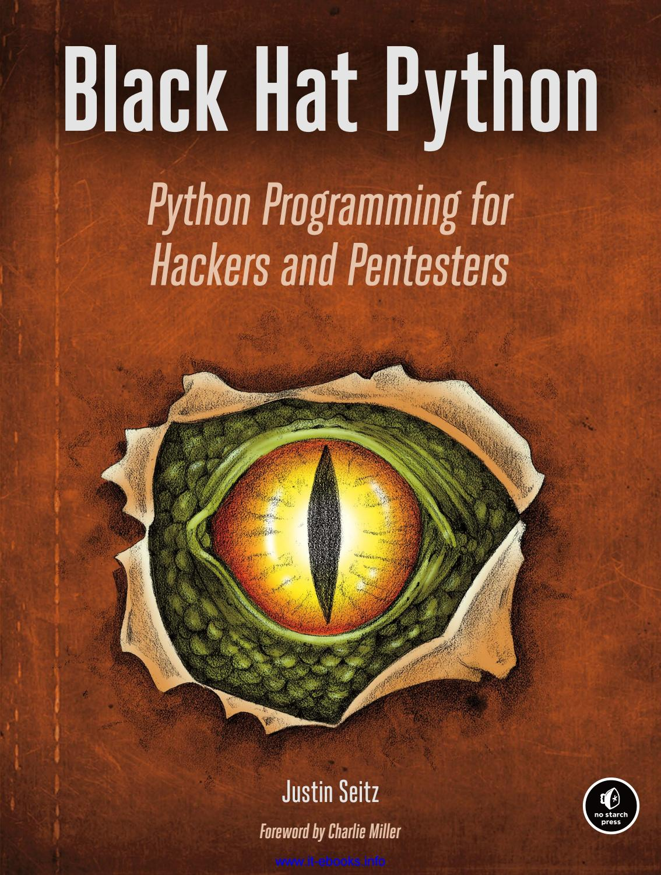
The Book
These slides are based on Justin Seitz’s Black Hat Python
The book has more information than the slides will
Justin Seitz is an interesting person
Justin Seitz’s book is an interesting book

Slide 4
Me
I’m an interesting person but I’m not as interesting as Justin Seitz
If you wish to contribute to these slides in anyway send me a message somehow

